Slide 1

DEPARTMENT OF ELECTRONICS AND COMMUNICATION ENGINEERING
MAJOR PROJECT - AY 2021-22
To analyze the dataset for air pollution by air quality prediction based on supervised with classification machine learning approach
BATCH NO – DG.12
Samala Arun Kumar(18P61A04I2)
Anthwar Navatha Rao(19P65A0423)
Geesa Manideep(16P61A0477)
Name of the Guide
Md. MOHSIN Ali

Slide 2
CONTENTS:
Abstract
Literature Survey
Objective
AQI definition
Block Diagram
Methodology
Algorithms
Applications
References

Slide 3
ABSTRACT:
Generally, Air pollution refers to the release of pollutants into the air that are detrimental to human health and the planet as a whole. It can be described as one of the most dangerous threats that the humanity ever faced.
It causes damage to animals, crops, forests etc. To prevent this problem in transport sectors have to predict air quality from pollutants using machine learning techniques.
Hence, air quality evaluation and prediction has become an important research area.
The aim is to investigate machine learning based techniques for air quality forecasting by prediction results in best accuracy.
The analysis of dataset by supervised machine learning technique(SMLT) to capture several information’s like, variable identification, uni-variate analysis, bi-variate and multi-variate analysis, missing value treatments and analyze the data validation, data cleaning/preparing and data visualization will be done on the entire given dataset.

Slide 4
Literature survey:
Generally in industries systems are located at different locations each has its own processor with its own tasks running inside it.
We cannot control or change the scheduling of these tasks running in a processor from control room so, every time person should move to particular location and change its scheduling of the tasks.
In proposed system we overcome the disadvantage of existing system by managing tasks of the system on a single chip using internet connection.

Slide 5
AIR QUALITY INDEX (AQI):
An Air Quality Index (AQI) is used by government agencies to communicate to the public how polluted the air currently is or how polluted it is forecast to become.Public health risks increase as the AQI rises.
Different countries have their own air quality indices, corresponding to different national air quality standards.
Some of these are :
1. The National Air Quality Index (India)
2. The Air Quality Health Index (Canada)
3. The Air Pollution Index (Malaysia)
4. The Pollutant Standards Index (Singapore).

Slide 6
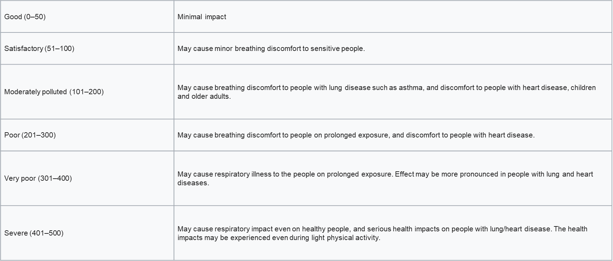
AQI Table:

Slide 7
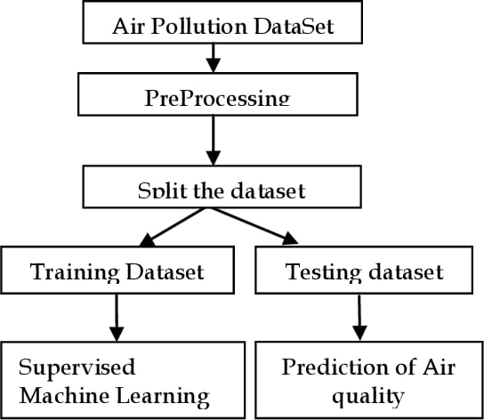
BLOCK DIAGRAM:

Slide 8
METHODOLOGY:
By analyzing historical data sets, associations are made between pollution levels and meteorological data variables. The result is an equation that can be used to forecast future pollution levels. Artificial neural networks use adaptive learning and pattern recognition techniques.
Predicting air quality, therefore, not only involves the difficulties of weather forecasting, it also requires data on and knowledge of:
Local pollutant concentrations and emissions.
Pollutant concentrations and emissions from distant locations.
Movements and possible transformations of pollutants.
Prevailing winds.

Slide 9
ALGORITHMS:
Logistic Regression
Decision Tree
K-Nearest Neighbor (KNN)
Random Forest
Support Vector Machines

Slide 10
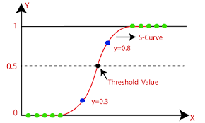
Logistic Regression:
Logistic regression is one of the most popular ML Algorithms for binary classification.
It deals with discrete values i.e: 0 or 1.

Slide 11
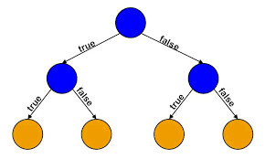
Decision Tree:
DECISION NODE
It is one of the predictive modelling approaches used in ML.
Decision Trees are constructed via algorithms approach that identities way to split a dataset based on different conditions.
These are used for both classification and regression tasks.
In Decision Tree, each internal node represents a test on a feature.
DECISION NODE
LEAF NODE

Slide 12
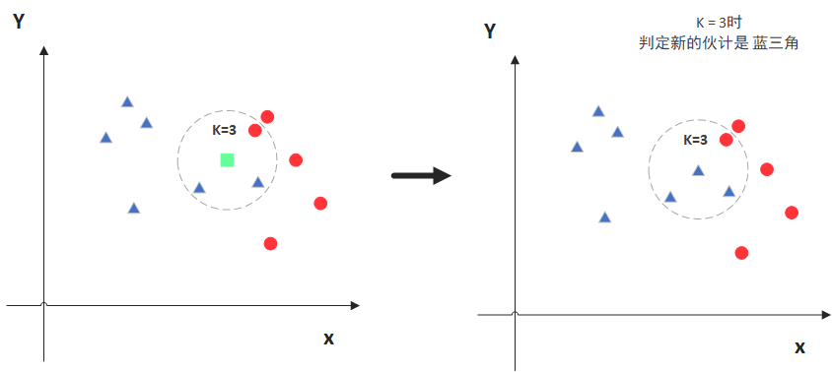

K-Nearest Neighbor (KNN):
It is a classification algorithm.
Converting the data to numeric(0 or 1).
It is using distance to classify the result/prediction.
The main drawback of KNN is the complexicity in searching the nearest neighbours for each sample.

Slide 13
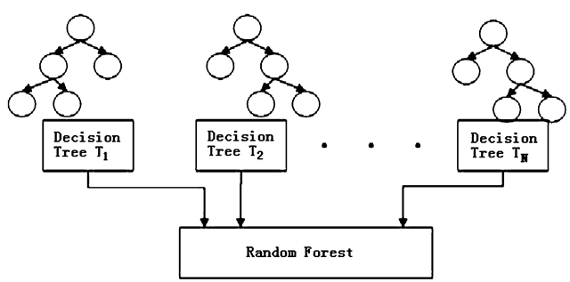
Random Forest:
Random Forest is a supervised ML technique that constructs decision tree.
The final decision is made based on the outcome of the majority of the decision trees.
Decision tree suffer from low bias & high varience(performs good for training but not for testing).
Random Forest introduce flexibility and converts High variance to Low bias.

Slide 14


Support Vector Machines:
SVM is a supervised machine learning algorithm which is a widely used classification algorithm.
SVM is applicable for the data that are linearly seperable.
SVM classifies the two classes using “Hyper plane”. This hyper-plane should have largest margin in a high dimension space to separate given into classes.
The margin between the 2 classes represents the longest distance between closest data points of those classes.

Slide 15
THANK YOU !
THANK YOU!

